Slide 1
PRESS RELEASE
CONSUMER PRICE INDEX AND INFLATION
9th March 2022

Slide 2
In this release, we present:
Definition and Measurement of Consumer Price Index (CPI) and Rate of Inflation
CPI and Rate of Inflation for February 2022
Dominant Divisions of Rate of Inflation for February 2022
Disaggregation of Rate of Inflation for February 2022
Highlights of CPI and Rate of Inflation for February 2022

Slide 3
Definition and measurement of CPI and rate of inflation (1/3)
CPI measures changes in the price of a fixed basket of goods and services purchased by households
The assumption is that the basket is purchased each month, hence as price changes each month, the total price of the basket will also change
The rate of inflation is the relative change in CPI between periods
Inflation is reported year-on-year (annual inflation) and month-on-month (monthly inflation), and granulated to determine regional and commodity type and source of inflation
2
2

Slide 4
Definition and measurement of CPI and rate of inflation (2/3)
CPI does not measure price levels
CPI is a price perspective measure and cost-of-living index is an expenditure oriented measure
Data (market readings) are captured monthly
Key variables are prices, quantities and expenditure weights of items
Price reference year is 2018 (2018 = 100)
3

Slide 5
Definition and measurement of CPI and rate of inflation (3/3)
Prices are collected for approximately 39,500 products every month.
Price collection is done in 44 markets
Prices are collected from 7,726 outlets.
Products are ordered in a hierarchy of 13 Divisions, 44 Groups, 98 Classes, 156 Subclasses and 307 Items.
Every Item can only be part of one Subclass, and every Subclass can only be part of one Class, etc.
4

Slide 6
Consumer Price Index and Rate of Inflation for Feb. 2022
CPI for February 2022 was 143.0 relative to 123.6 in February 2021
Year-on-year inflation rate for February 2022 was 15.7%
This means that in the month of February 2022 the general price level was 15.7% higher than in February 2021
Month-on-month inflation between January 2022 and February 2022 was 2.4%
Month | CPI | Inflation |  | Quarterly Averages
 |  | Monthly | Yearly | Quarterly Averages
Jan-2021 | 122.7 | 0.9% | 9.9% | Q1: 10.2%
Feb-2021 | 123.6 | 0.8% | 10.3%
Mar-2021 | 124.7 | 0.9% | 10.3%
Apr-2021 | 126.6 | 1.5% | 8.5% | Q2: 7.9%
May-2021 | 127.6 | 0.8% | 7.5%
June-2021 | 129.2 | 1.3% | 7.8%
Jul-2021 | 131.3 | 1.6% | 9.0% | Q3: 9.8%
Aug-2021 | 131.7 | 0.3% | 9.7%
Sept-2021 | 132.5 | 0.6% | 10.6%
Oct-2021 | 133.3 | 0.6% | 11.0% | Q4: 11.9%
Nov-2021 | 135.2 | 1.4% | 12.2%
Dec-2021 | 136.9 | 1.2% | 12.6%
Jan-2022 | 139.7 | 2.1% | 13.9%
Feb-2022 | 143.0 | 2.4% | 15.7%
5
Notes:
Year-on-Year inflation for February 2022 (15.7%) was 1.8 percentage points higher than the rate recorded for January 2022 (13.9%), the second highest difference since rebasing in August 2019.

Slide 7
Disaggregation of February 2022 rate of inflation
Food inflation was 17.4%
  Last month this was 13.7%
  Average over last 12 month was 10.8%
  Month-on-month Food inflation was 3.2%.
Non-food Inflation was 14.5%
  Last month this was 14.1 %
  Average over last 12 month was 10.7%
  Month-on-month Non-Food inflation was 1.7%
Inflation for locally produced items was 16.7%
Inflation for imported items was 12.9%
6
Notes:
Food inflation for February 2022 was 17.4%, indicating 2.9 percentage point inflation higher than non-inflation (14.5%)
Food inflation for February 2022 recorded a 3.7 percentage point increase compared to January 2022
Food inflation for February 2022 recorded a 6.6 percentage point increase in relative to the average over the last 12 month March 2021 to February. 2022
Non-Food inflation for February 2022 recorded a 0.4 percentage point increase compared to January 2022
Non-Food inflation for February 2022 recorded a 3.8 percentage point increase in relative to the average over the last 12 month March 2021 to February. 2022
Month-on-Month food inflation (3.2%) surpassed non-food inflation (1.7%) by 1.5 percentage points
Variation in locally produced items (16.7%) and imported items (12.9%) for January 2022 was 3.8 percentage points

Slide 8
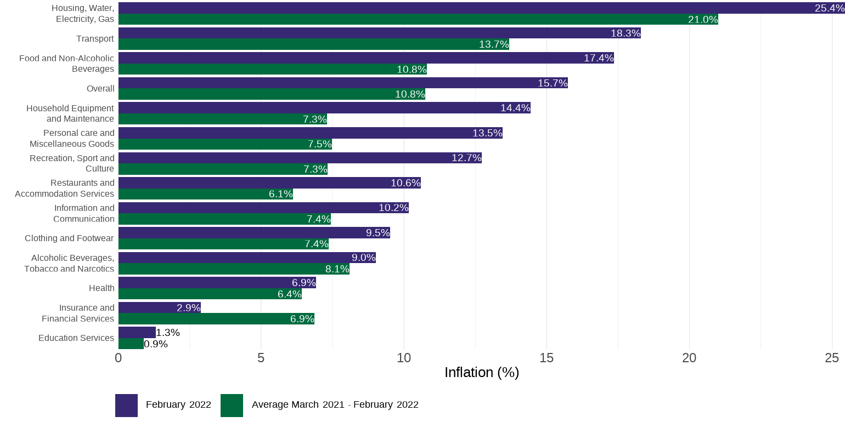
Disaggregation of year-on-year inflation by Division
7
Notes:
Inflation for Housing, Water, Electricity and Gas (25.4%) which is about 10 percentage points higher than the national average but lower than the rate recorded for January 2022 (28.7%)
Transport (18.3%) was the other second division the saw a higher inflation than the national average
In contrast to January 2022, Food and Non-alcoholic beverages (17.4%) also recorded a rate higher than the national average
All then other 10 divisions recorded inflation rates lower than the national average.
Education (1.3%) continue to record the least inflation

Slide 9
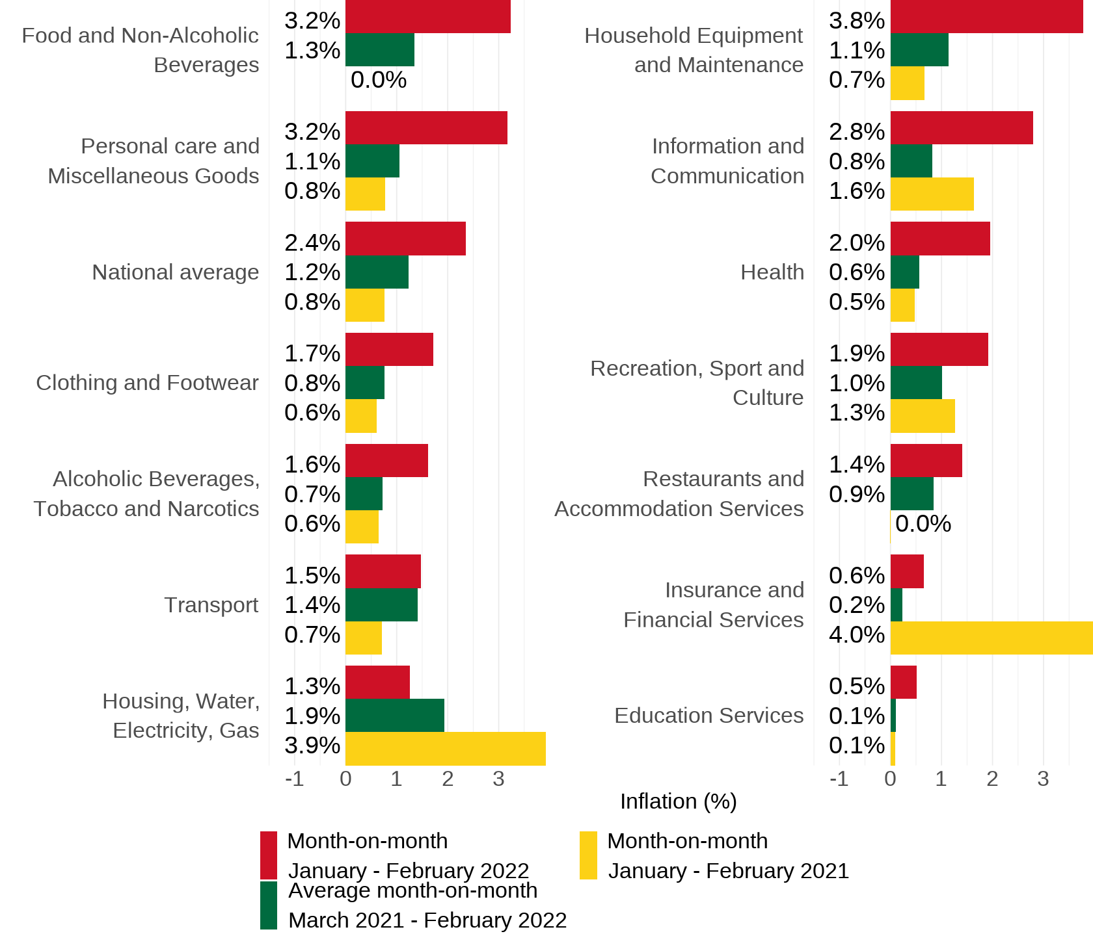
Disaggregation of month-on-month inflation
Notes:
On a month and month basis, three divisions {Housing, Water, Electricity and Gas (3.8%); Food and Non-alcoholic beverages (3.2%) and Personal care and Miscellaneous Goods (3.2%)} recorded rates higher than the national average (2.4%)
Education (0.1%) recorded the least month and month inflation

Slide 10
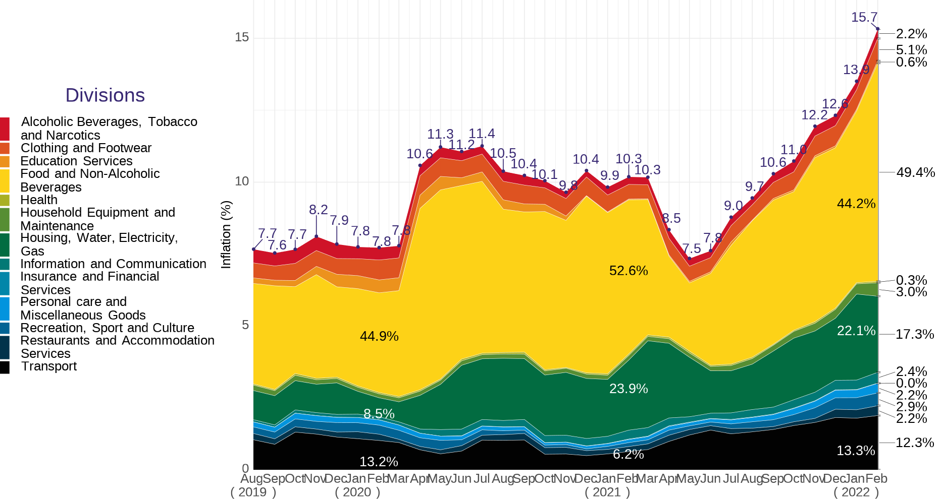
Composition of year-on-year inflation
9
Notes:
Contribution of Housing, Water, Electricity and Gas reduces by 4.8 percentage points (from 22.1% to 17.5%) while food and non-alcoholic beverages increases by 5.2 percentage points (from 44.2% to 49.2%) and transport also reduces by one percentage points (from 13.3% to 12.3%).
The three divisions - Housing, Water, Electricity and Gas; Transport and food and non-alcoholic beverages - account for almost 80 percent of inflation recorded for February 2022

Slide 11
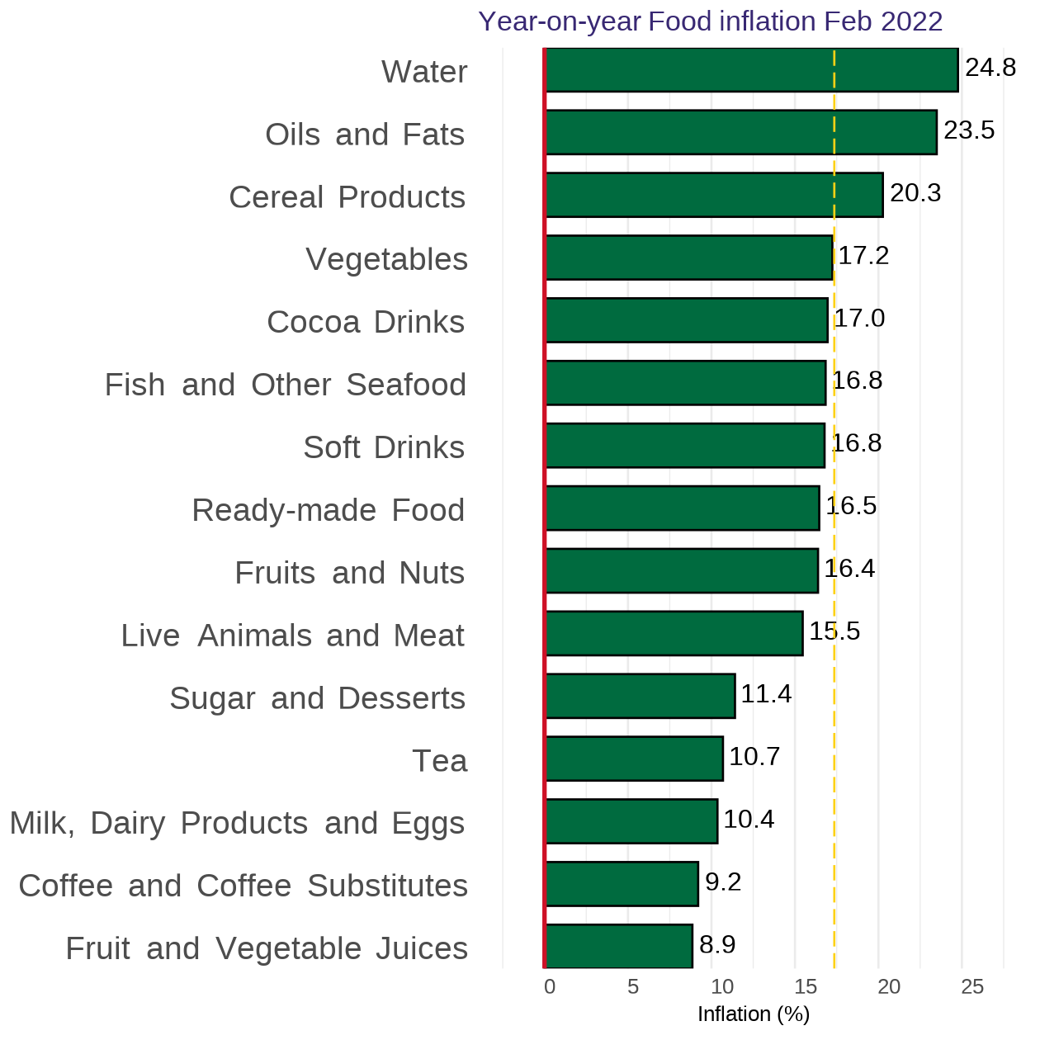
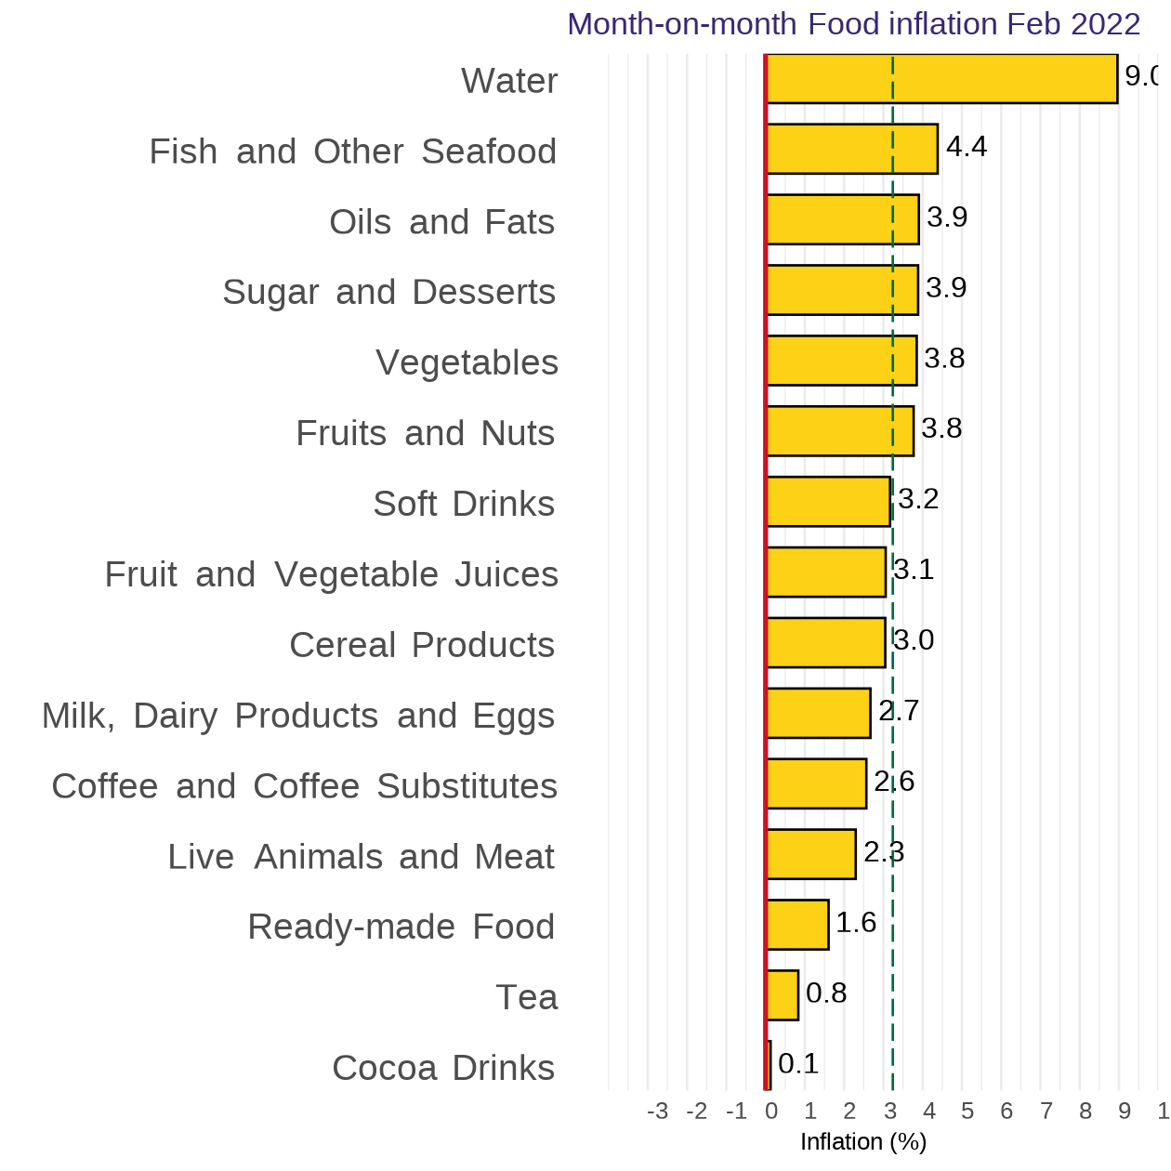
Disaggregation of YoY and MoM Food-inflation by Subclass
10
Notes:
Three subclasses within the food division category recorded inflation higher than overall Y-o-Y food inflation (17.4%) for February 2022. Water recorded the highest 24.8% followed by Oils and Fats 23.5%
Six subclasses within the food division category recorded inflation rates higher than overall M-o-M (2.4%) for February 2022. Water recorded the highest 9.0%, followed Fish and Other Sea Food, 4.4%.

Slide 12
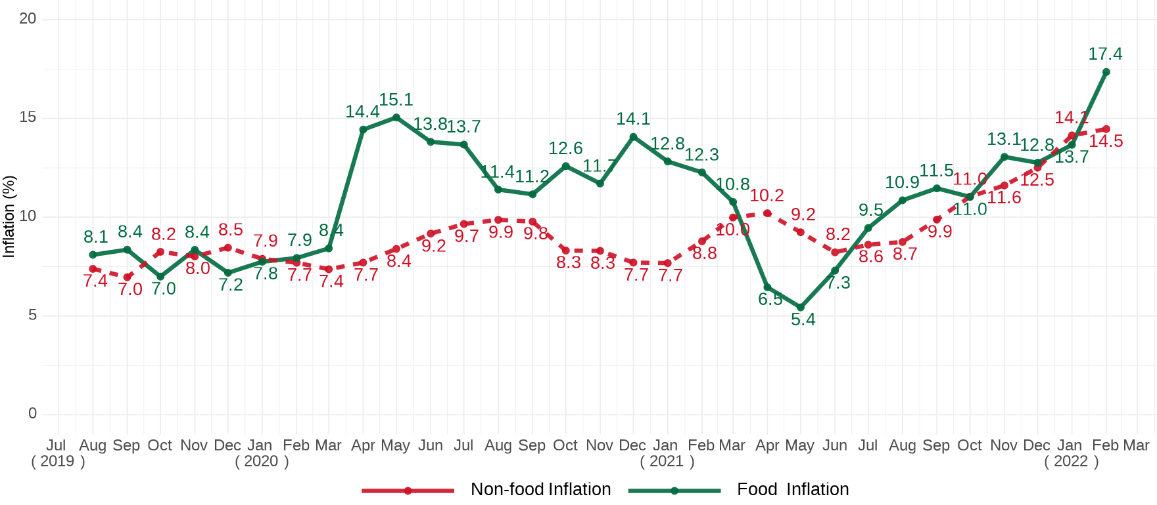
Food & Non-Food year-on-year inflation Jul. 19–Feb. 22
Notes:
Food inflation regains it dominance over non-food inflation by 2.9 percentage points

Slide 13
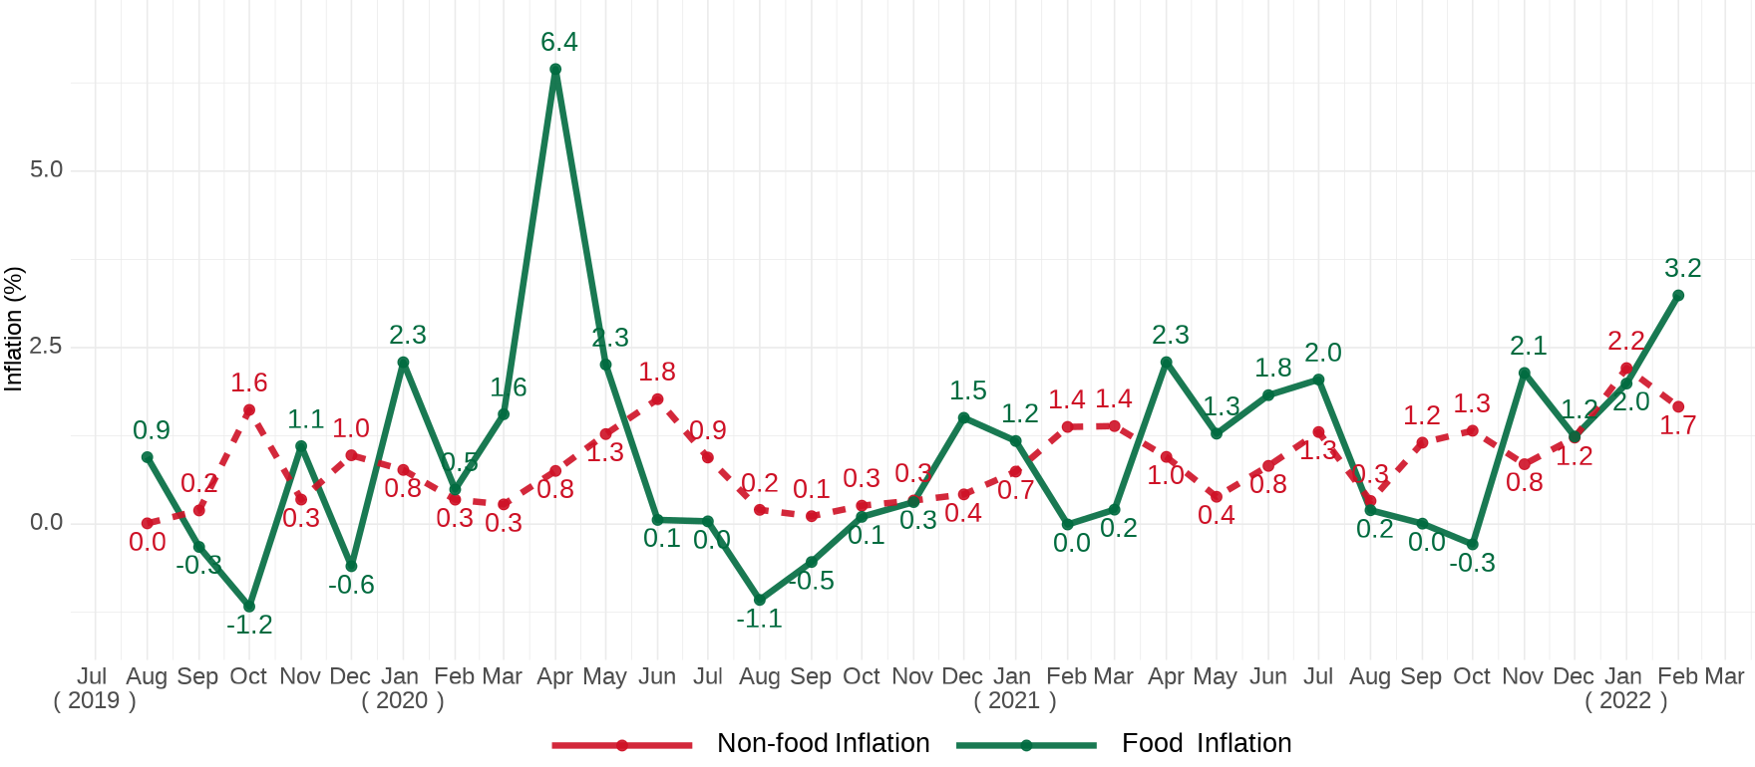
Food & Non-Food month-on-month inflation Aug. 2019–Jan. 2022
Notes:
On a month-on-month basis food and non-food inflation move opposite directions with food inflation surpassing non-food inflation by 1.5 percentage points

Slide 14
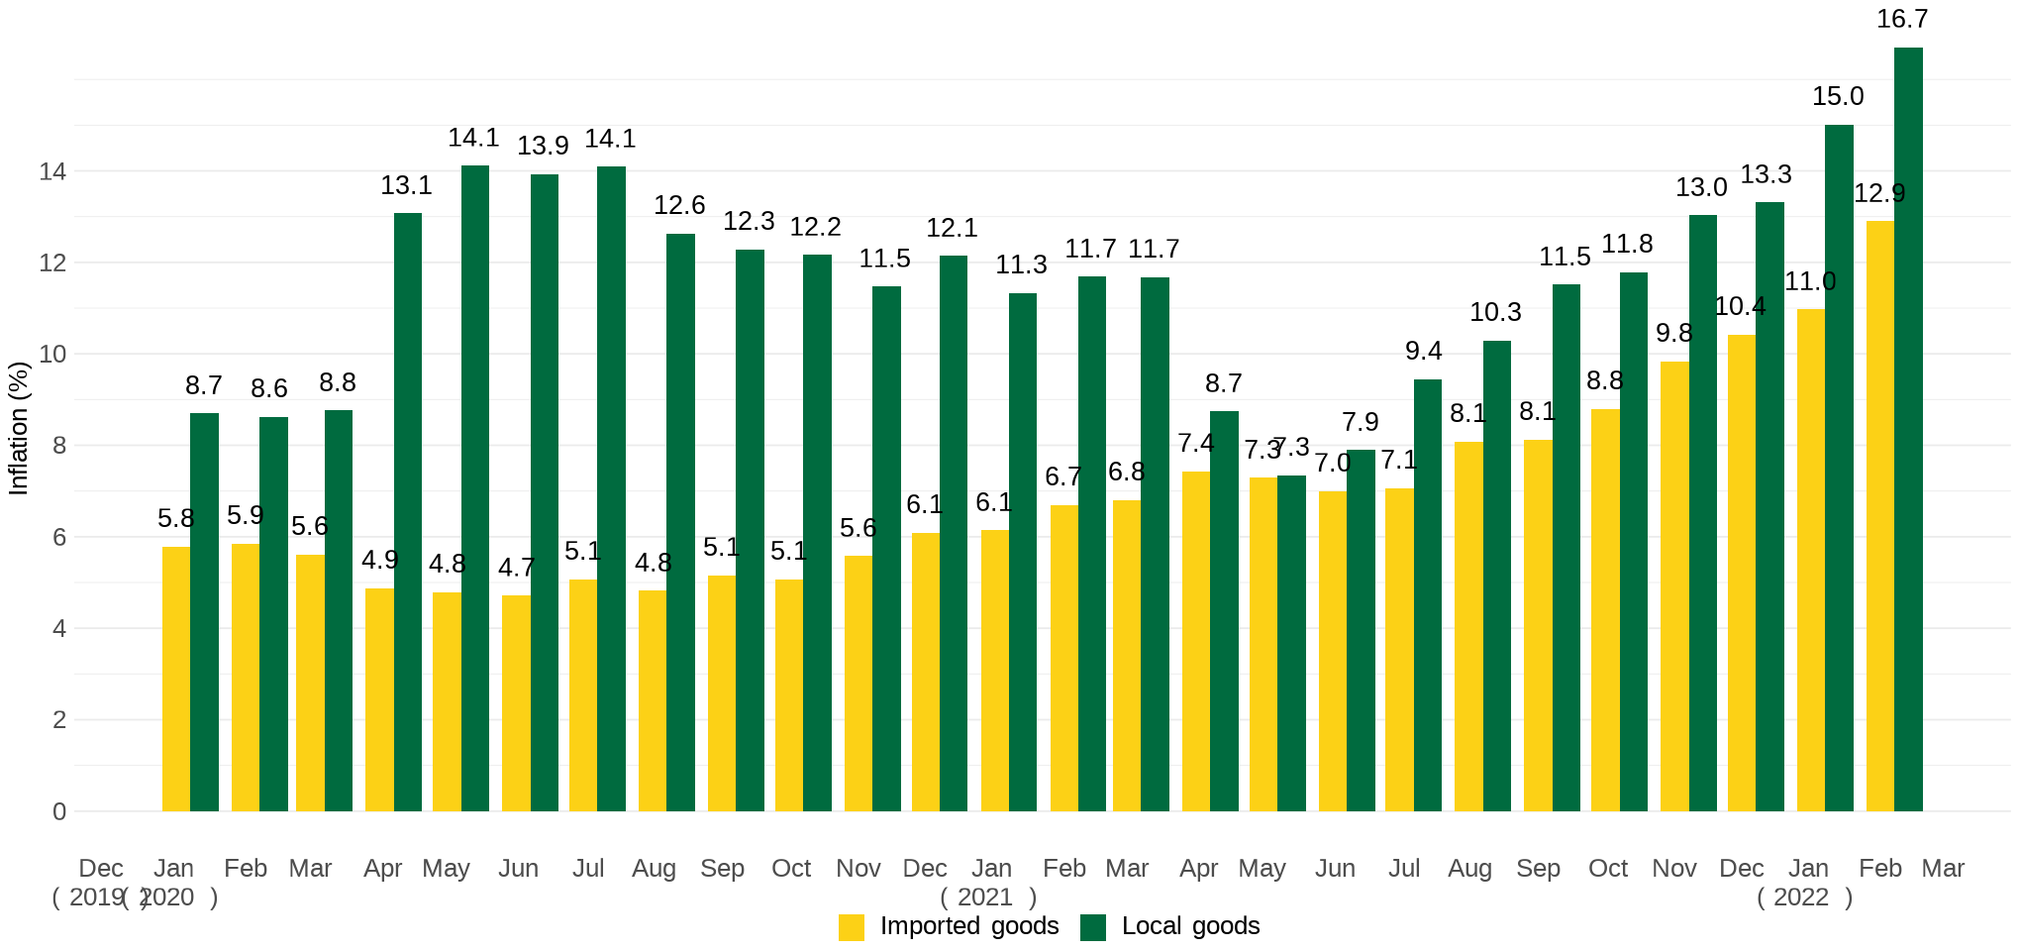
Imported and local inflation January 2020 – February 2022
Notes:
The gap between locally produced item and imported items is sustained in February 2022.

Slide 15
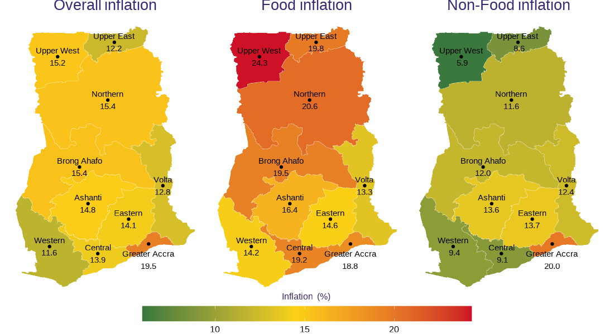
February 2022 regional rates of inflation
14
Notes:
Upper West (24.3%) continue to record the highest food inflation followed by Northern and Upper East regions recording 20.6% and 19.8% respectively
Greater Accra (20.0%) recorded the highest non-food inflation and distantly followed by Eastern Region (13.7%) with Upper West the lowest (5.9%)
Wider variability is observed across the regions for non-food inflation (14.1%) compared to food inflation (11.0%)
Greater Accra (19.5%) recorded the highest overall inflation, with a margin 3.8 percentage points higher than the national average (15.7%).

Slide 16
Disaggregation of inflation in Gt. Accra Region for Feb. 2022
15
Notes:
In Greater Accra, inflation was largely driven by Housing, Water, Electricity and Gas (36.1%), Transport (20.9%) and Food and Non-Alcoholic Beverages (18.8%).
Within the food division in Greater Accra, Ready-made Food (22.5%) with the largest weight recorded the third highest inflation

Slide 17
Highlights
Year-on-year inflation for February 2021 – February 2022 was 15.7%.
Month-on-month (January 2022 - February 2022) inflation was 2.4%.
Food inflation has re-gained its dominance over non-food (17.4% versus 14.5% respectively).
On month-on-month basis, food inflation also exceeds non-food inflation this month by 1.5 percentage points (3.2% vs. 1.7%)
Housing, Transport (which includes fuel) and Food were the Divisions that recorded the highest inflation (25.4%, 18.3% and 17.4% respectively)
Contribution of food and non-Alcoholic beverages to overall inflation increased by 5.2 percentage points this month (from 44.2% in Jan. 2022 to 49.4% in Feb. 2022).
The gap between the inflation for locally produced items and imported items is retained
Greater Accra Region (19.5%) has recorded the highest inflation and Western Region the lowest (11.6%)
The divisions contributing to inflation vary across the regions
16

Slide 18
End of Press Release for
February 2021 Consumer Price Index
For enquiries, please contact:
https://statsghana.gov.gh/gssmain/fileUpload/Price%20Indices/CPI_Technical_Guide_v5_Published_14102020.pdf
Mr. John F.K. Agyaho
(Head, Price Statistics, GSS)
john.agyaho@statsghana.gov.gh

Slide 19
Consumer Price Index and Inflation
February 2021

